Slide 1
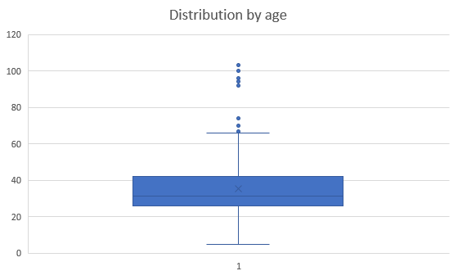
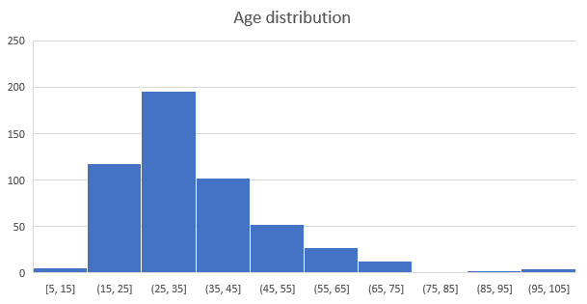
CHECKING AGE GROUP USING BOX_PLOTS AND HISTOGRAM
The Boxplot chart: shows the distribution of age. However, the number of borrowers are in range from 15 to just above 40 was common
People aged larger than around 70 and below 5 are outliers. They need to be remove
More concisely, the histogram chart points out the range of people borrowing appears larger than 15 and less than 75

Slide 2
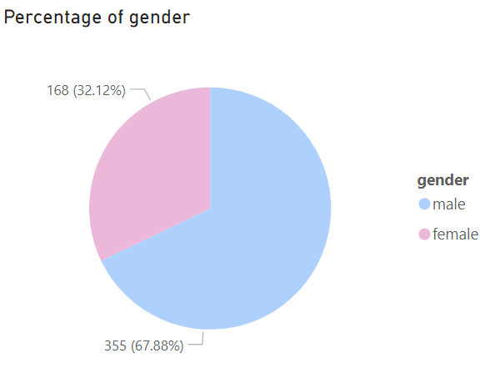
The percentage of age (male and female)
As the chart shows, the percentage of male accounted for around 68% out of 100%. This means male have a larger borrowers than female.
The bar chart indicates the purposes differentiate by gender (between male and female).
It is clearly that male spend much of their borrowing in business and repairs

Slide 3
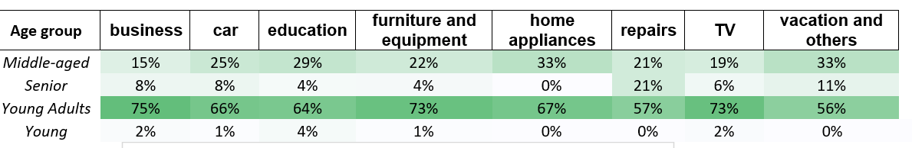
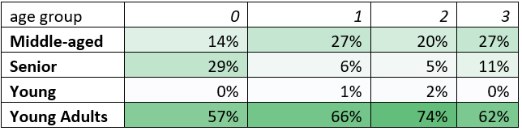
Compare of loan purpose by age group
Depending on the table, as we can see, Young Adults is the group which spend huge amount of money in different purposes.
However, Senior focuses on repairs
Middle-age prefers car, education, home applicances and vacation
Job distribution by age-range
• Young Adults: This age group consistently has the highest percentages across all categories, suggesting they may be more active or engaged in the activity represented by these categories.
• Seniors: This age group generally has lower percentages across all categories, indicating less participation or interest in these activities.

Slide 4
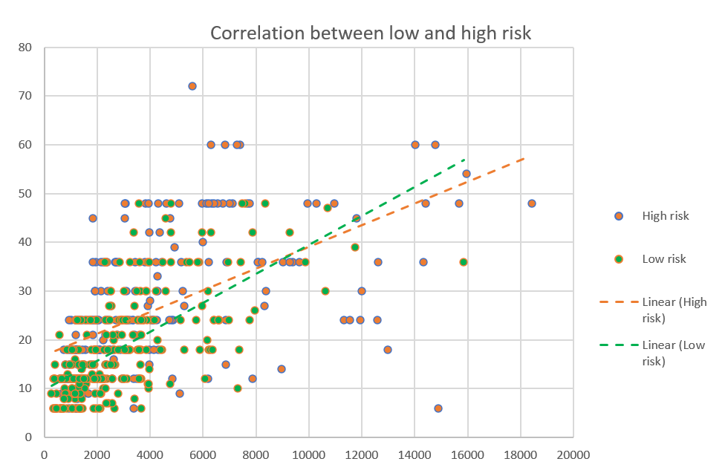
Correlation chart to get insight into risk level
As the loan amount increases, high risk loan duration also go up.
The high risk trendline is higher than low-risk line. This means the larger of the loan, the higher risk level

Slide 5
COMPARE BETWEEN HIGH AND LOW RISK
The group of people who have no housing account for higher risk of loan.
People owning house have a low risk of loan, however, the risk still exist due to buying cars or house

